Slide 1


Slide 2
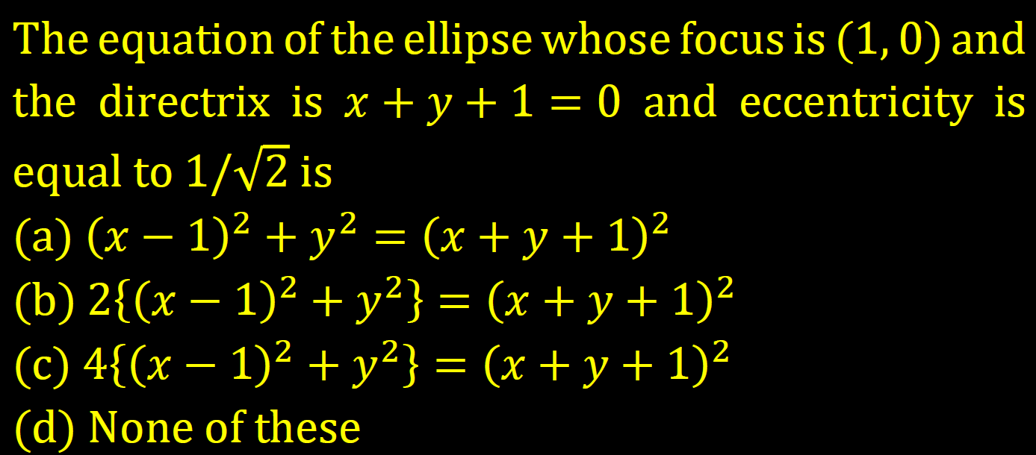

Slide 3
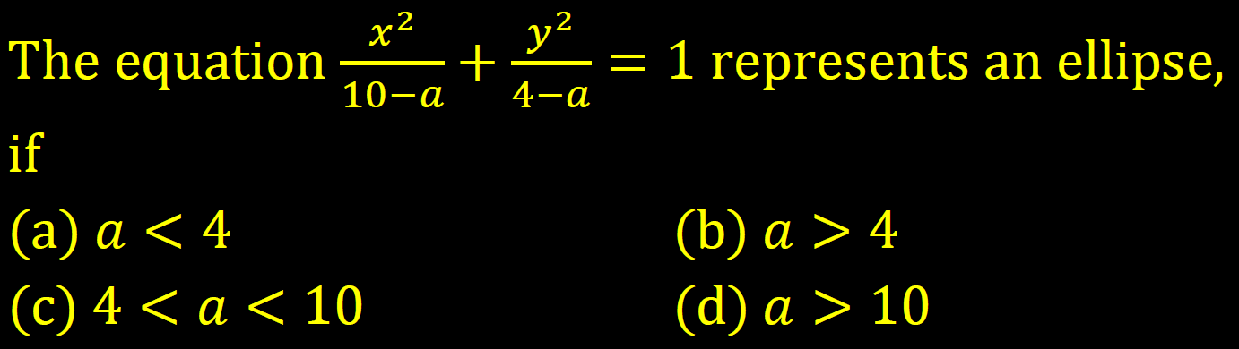

Slide 4
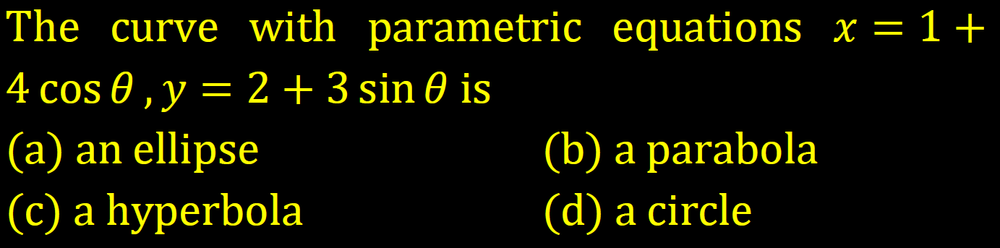

Slide 5
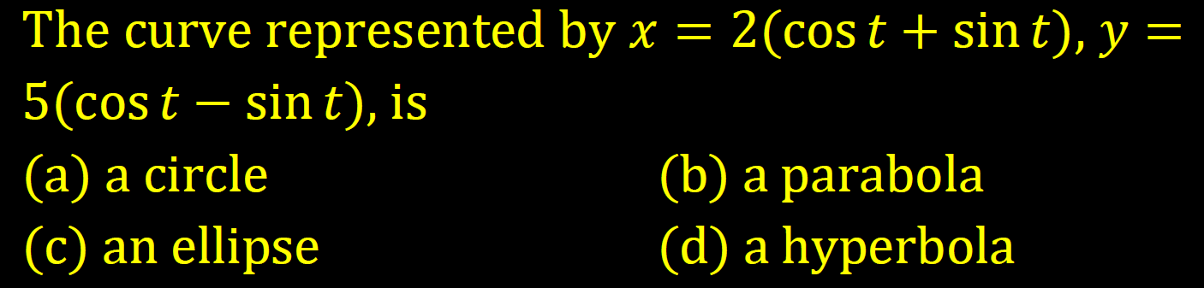

Slide 6
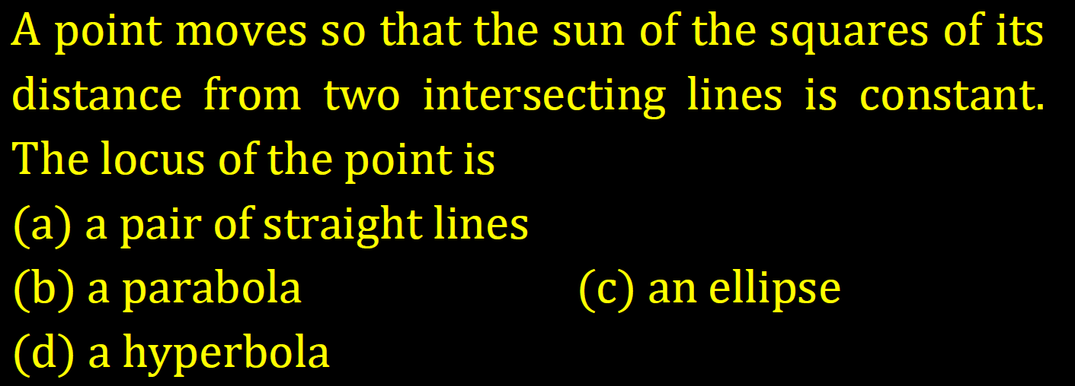

Slide 7
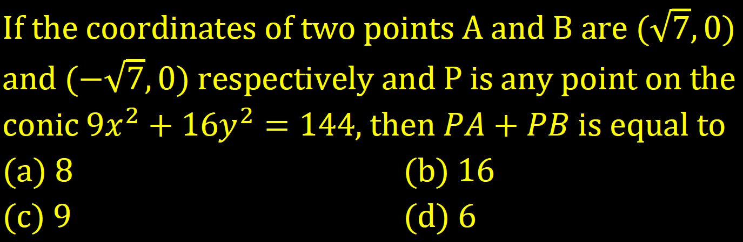

Slide 8
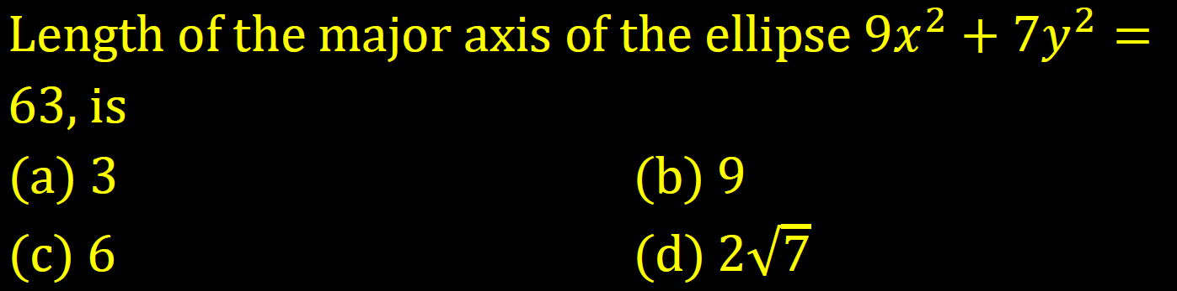

Slide 9
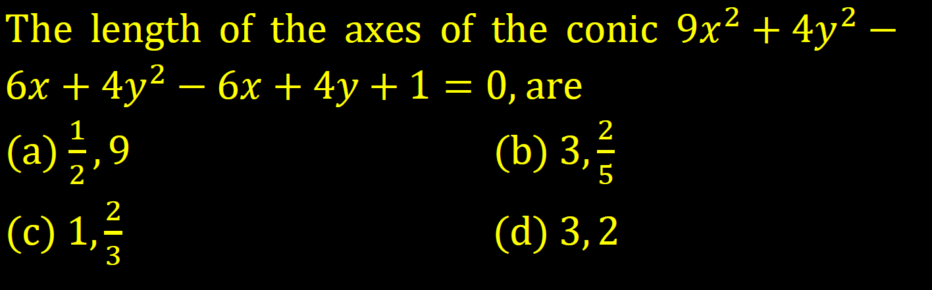

Slide 10
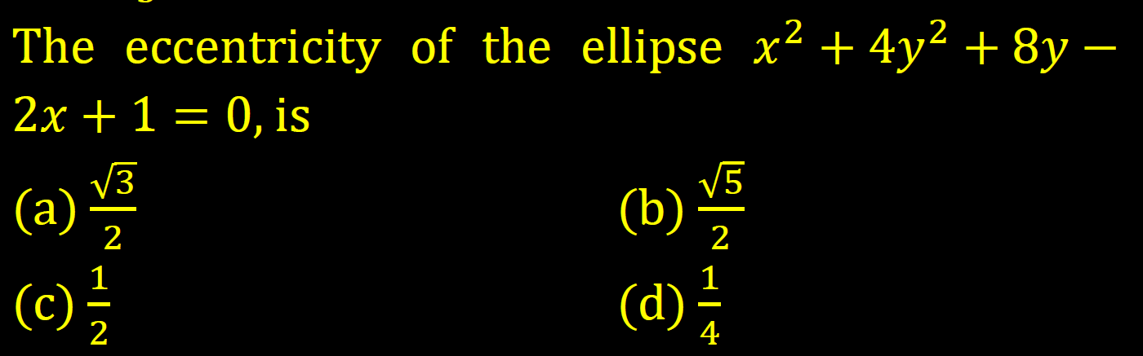

Slide 11
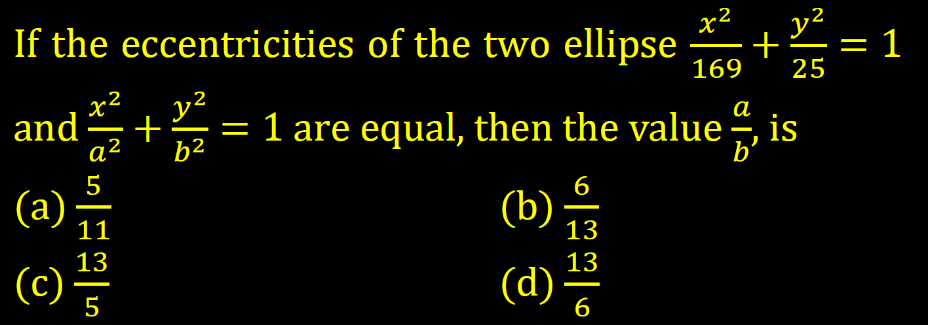

Slide 12
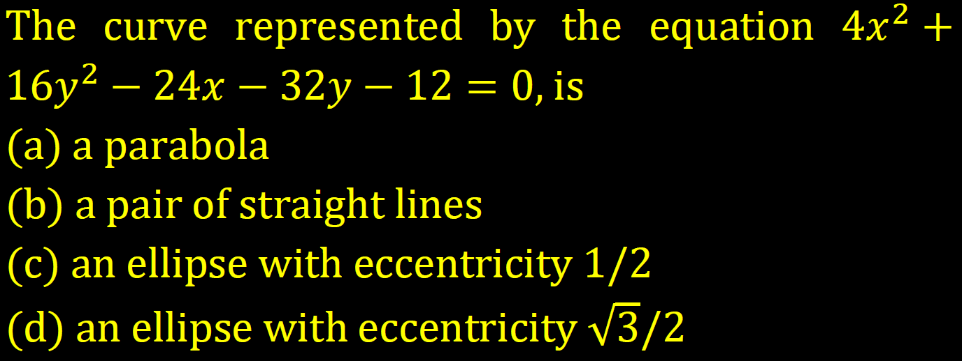

Slide 13
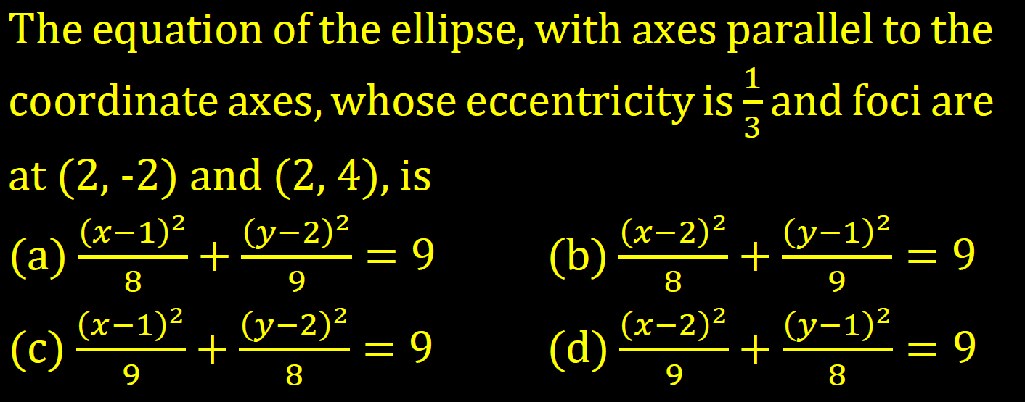

Slide 14
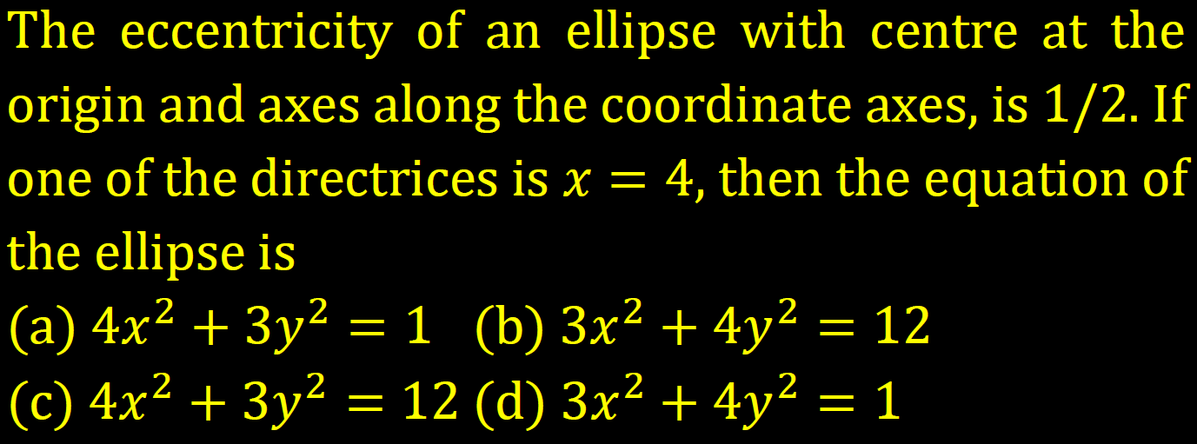

Slide 15
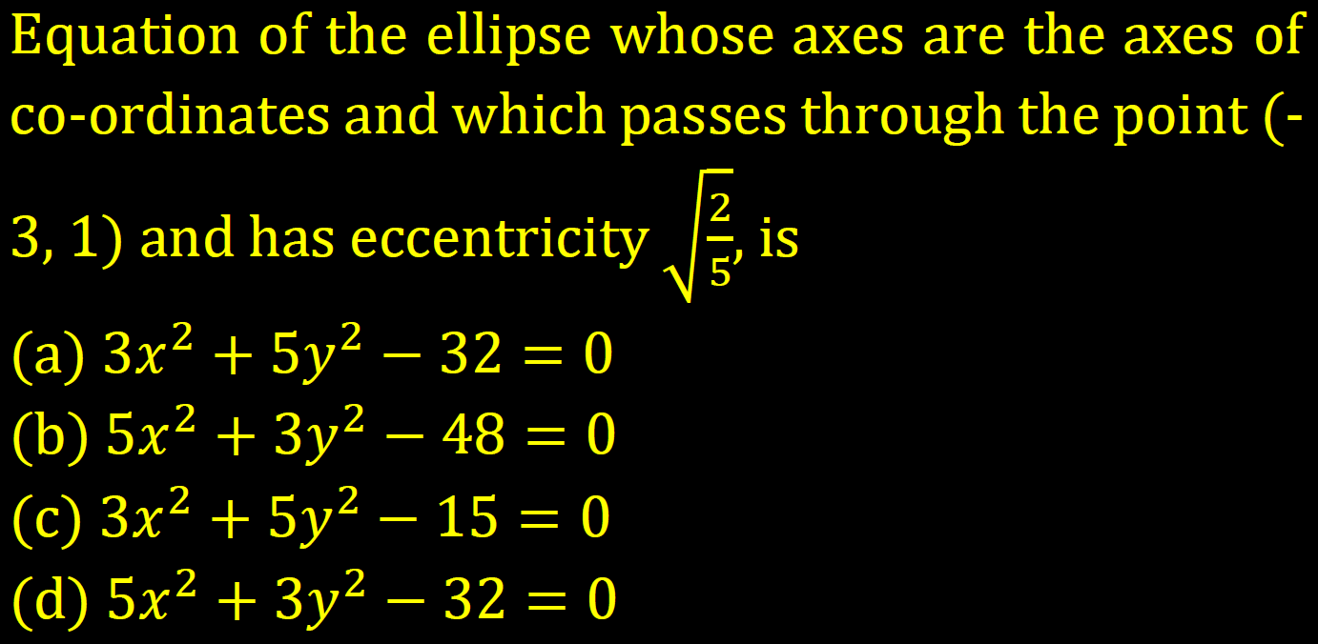

Slide 16
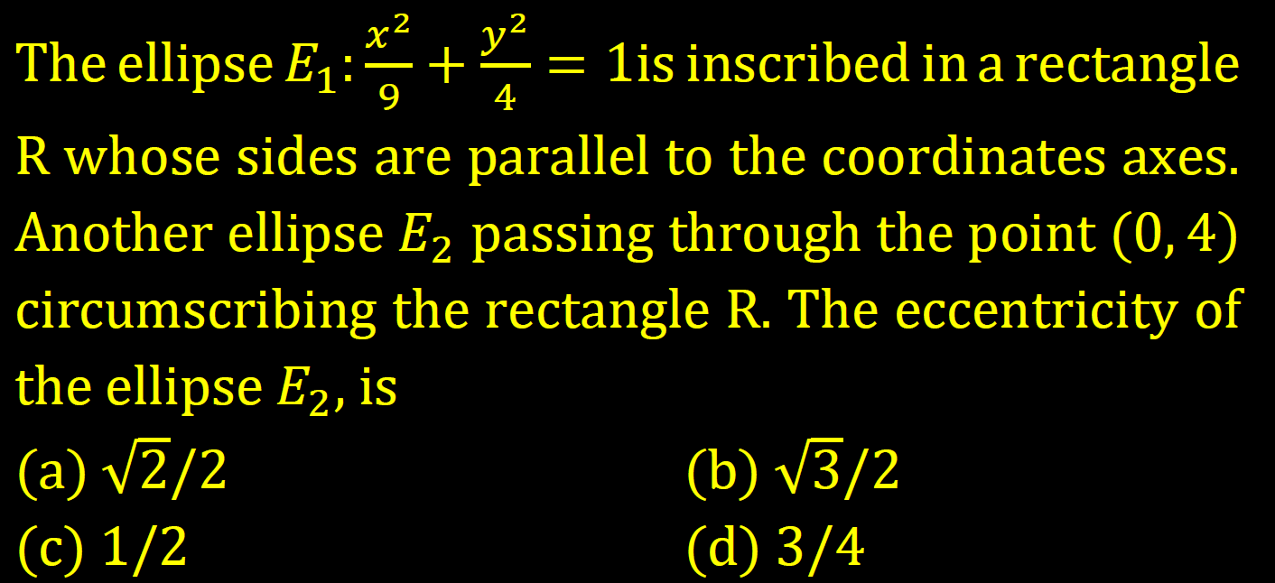

Slide 17
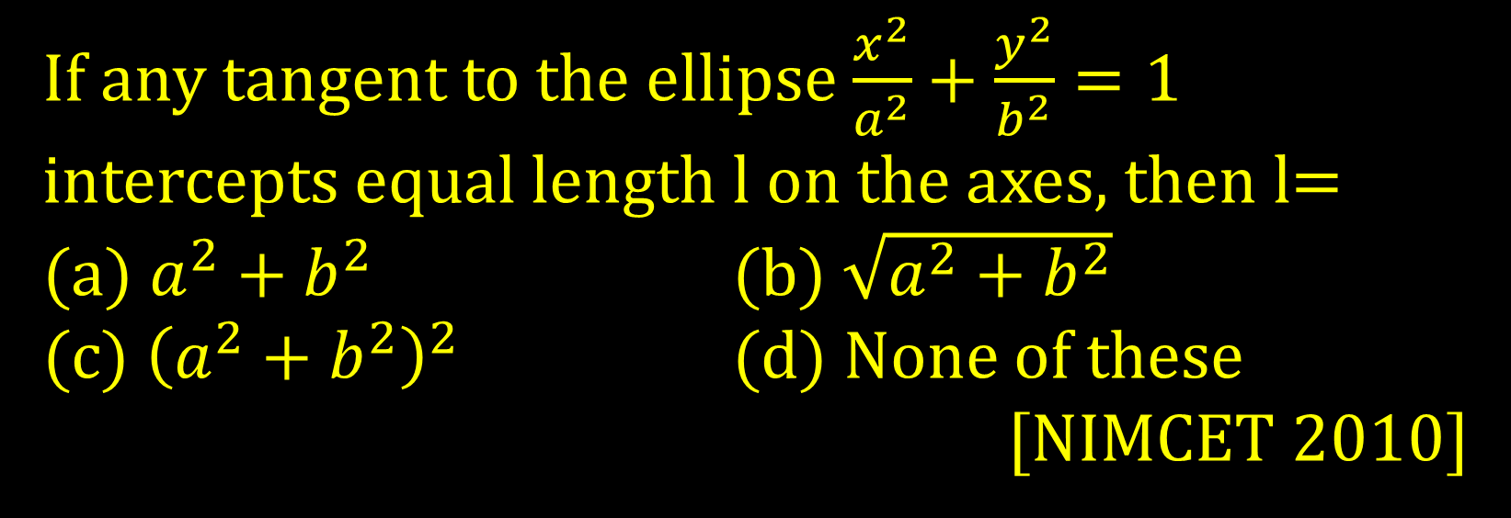
If any tangent to the ellipse $\frac{x^{2}}{a^{2}}+\frac{y^{2}}{b^{2}}=1$ intercepts equal length l on the axes, then l=
(a) $a^{2}+b^{2}$ (b) $\sqrt{a^{2}+b^{2}}$
(c) ${\left(a^{2}+b^{2}\right)}^{2}$ (d) None of these
[NIMCET 2010]

Slide 18
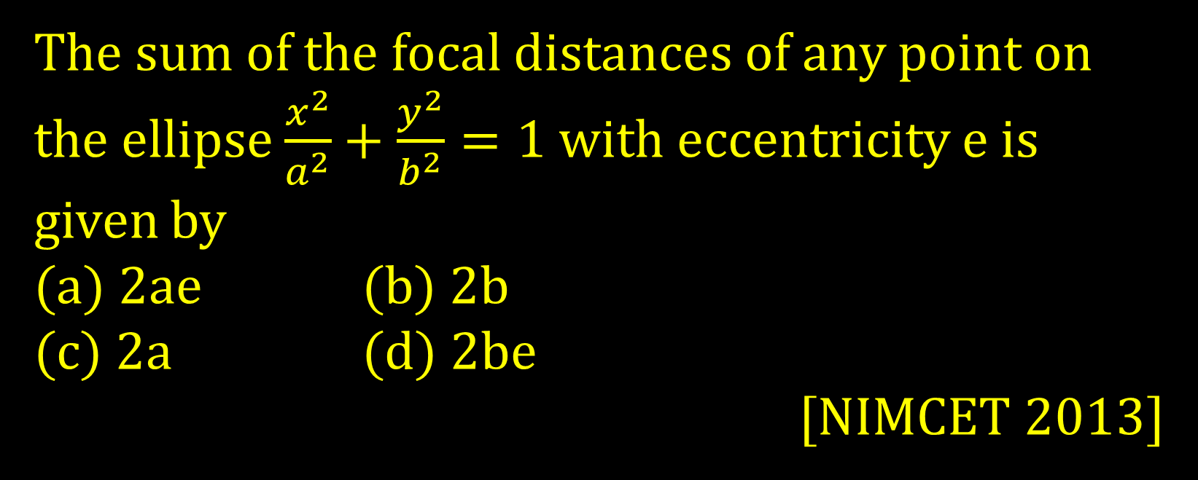
The sum of the focal distances of any point on the ellipse $\frac{x^{2}}{a^{2}}+\frac{y^{2}}{b^{2}}=1$ with eccentricity e is given by
(a) 2ae (b) 2b
(c) 2a (d) 2be
[NIMCET 2013]

Slide 19
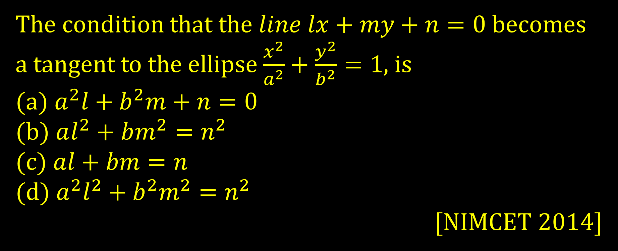
The condition that the $line lx+my+n=0$becomes a tangent to the ellipse $\frac{x^{2}}{a^{2}}+\frac{y^{2}}{b^{2}}=1$, is
(a) $a^{2}l+b^{2}m+n=0$
(b) $al^{2}+bm^{2}=n^{2}$
(c) $al+bm=n$
(d) $a^{2}l^{2}+b^{2}m^{2}=n^{2}$
[NIMCET 2014]

Slide 20
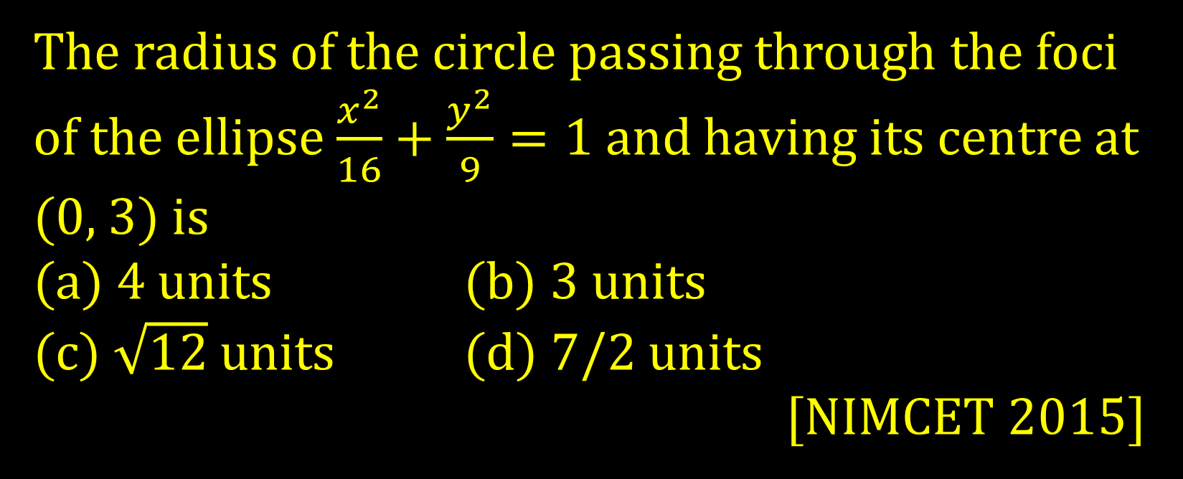
The radius of the circle passing through the foci of the ellipse $\frac{x^{2}}{16}+\frac{y^{2}}{9}=1$ and having its centre at (0, 3) is
(a) 4 units (b) 3 units
(c) $\sqrt{12}$ units (d) 7/2 units
[NIMCET 2015]

Slide 21
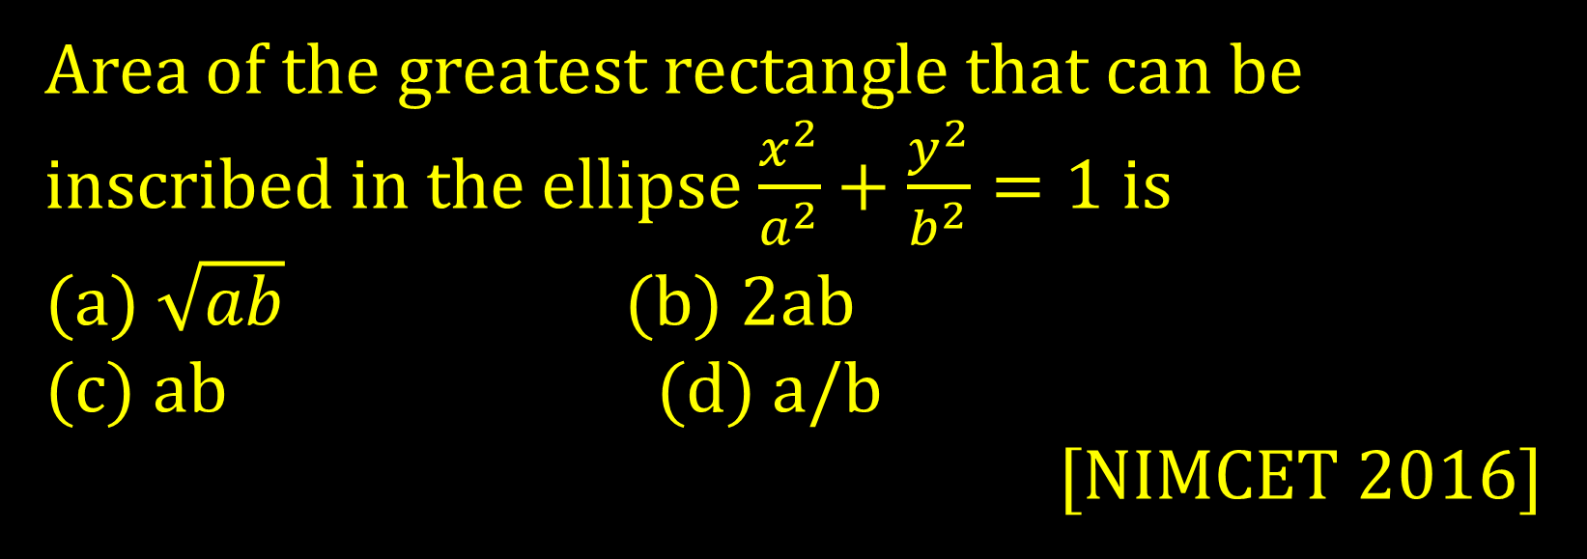
Area of the greatest rectangle that can be inscribed in the ellipse $\frac{x^{2}}{a^{2}}+\frac{y^{2}}{b^{2}}=1$ is
(a) $\sqrt{ab}$ (b) 2ab
(c) ab (d) a/b
[NIMCET 2016]

Slide 22
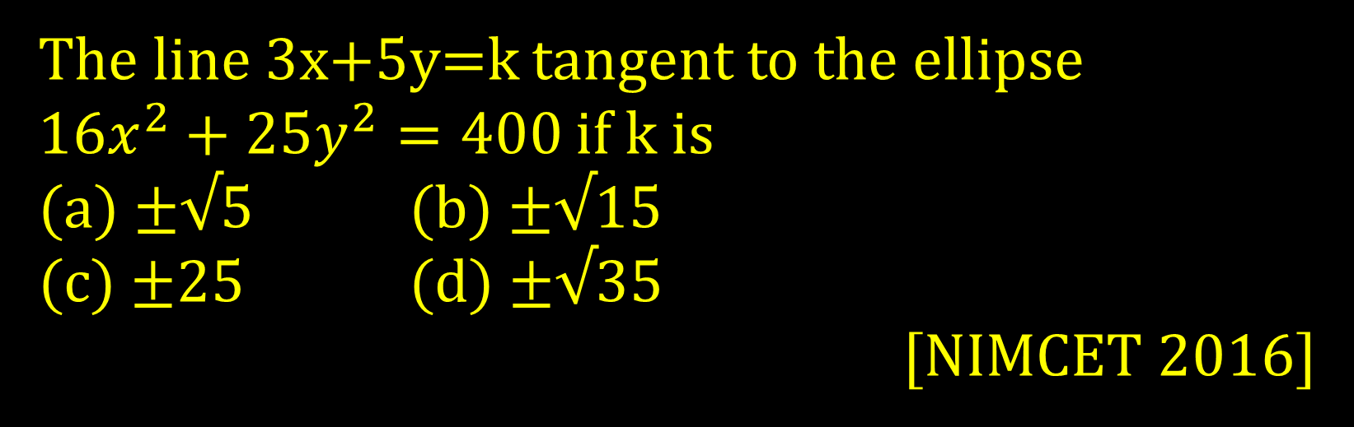
The line 3x+5y=k tangent to the ellipse $16x^{2}+25y^{2}=400$ if k is
(a) ±√5 (b) ±√15
(c) ±25 (d) ±√35
[NIMCET 2016]

Slide 23
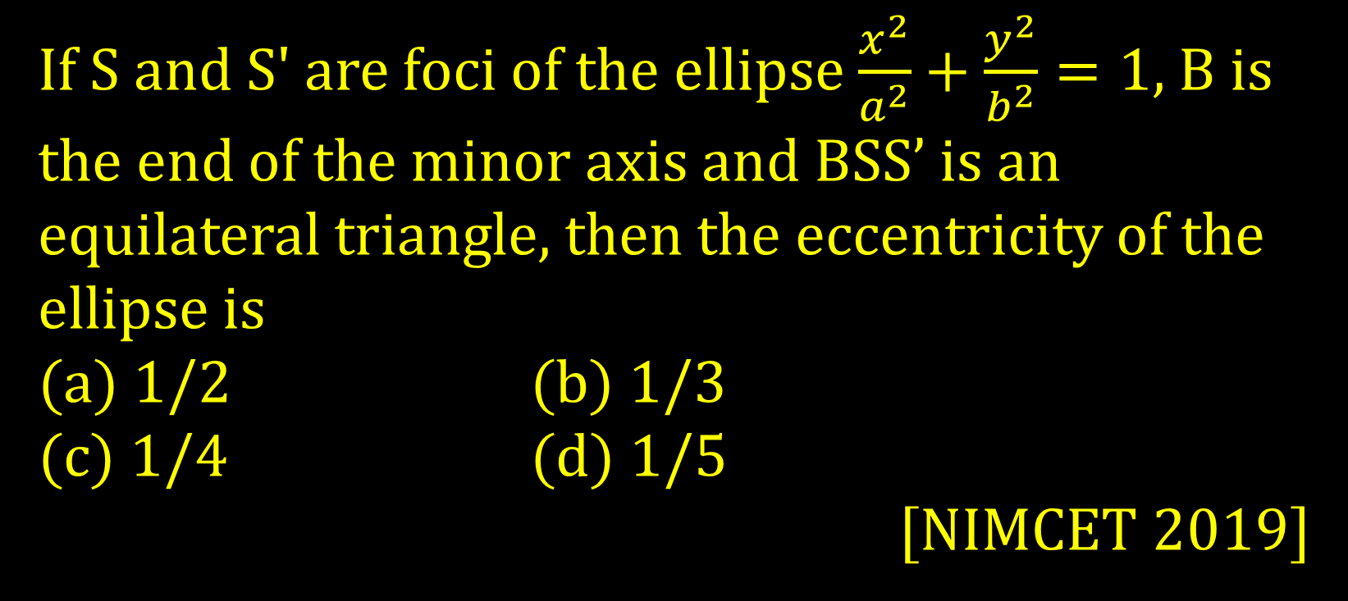
If S and S' are foci of the ellipse $\frac{x^{2}}{a^{2}}+\frac{y^{2}}{b^{2}}=1$, B is the end of the minor axis and BSS’ is an equilateral triangle, then the eccentricity of the ellipse is
(a) 1/2 (b) 1/3
(c) 1/4 (d) 1/5
[NIMCET 2019]

Slide 24
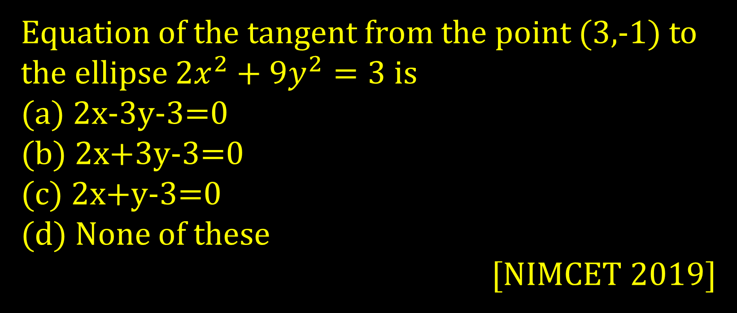
Equation of the tangent from the point (3,-1) to the ellipse $2x^{2}+9y^{2}=3$ is
(a) 2x-3y-3=0
(b) 2x+3y-3=0
(c) 2x+y-3=0
(d) None of these
[NIMCET 2019]

Slide 25
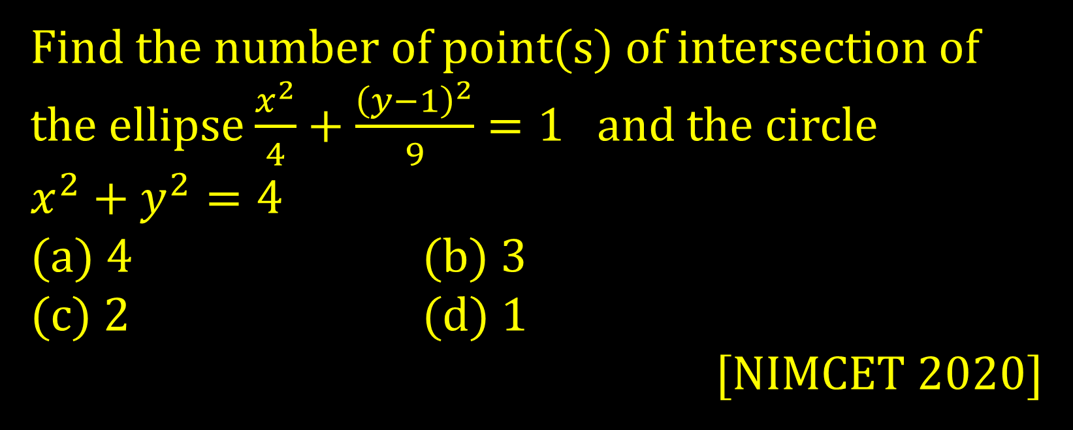
Find the number of point(s) of intersection of the ellipse $\frac{x^{2}}{4}+\frac{{\left(y−1\right)}^{2}}{9}=1$and the circle
$x^{2}+y^{2}=4$
(a) 4 (b) 3
(c) 2 (d) 1
[NIMCET 2020]

Slide 26
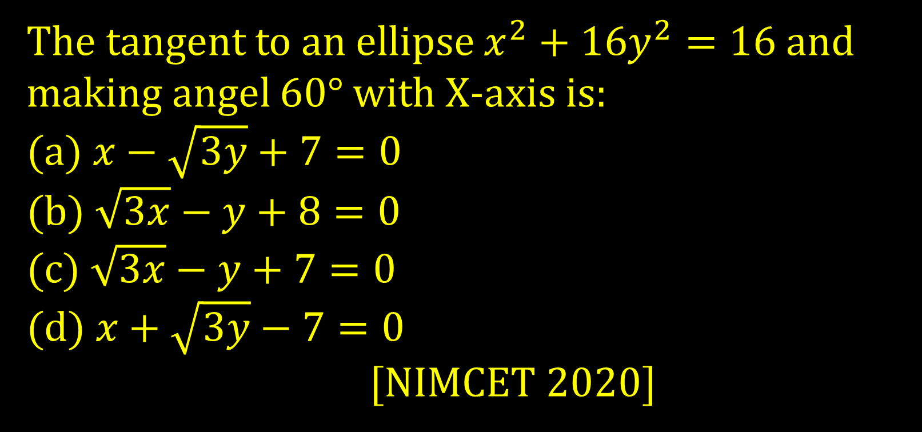
The tangent to an ellipse $x^{2}+16y^{2}=16$ and making angel 60° with X-axis is:
(a)$x−\sqrt{3y}+7=0$
(b) $\sqrt{3x}−y+8=0$
(c) $\sqrt{3x}−y+7=0$
(d) $x+\sqrt{3y}−7=0$
[NIMCET 2020]

Slide 27
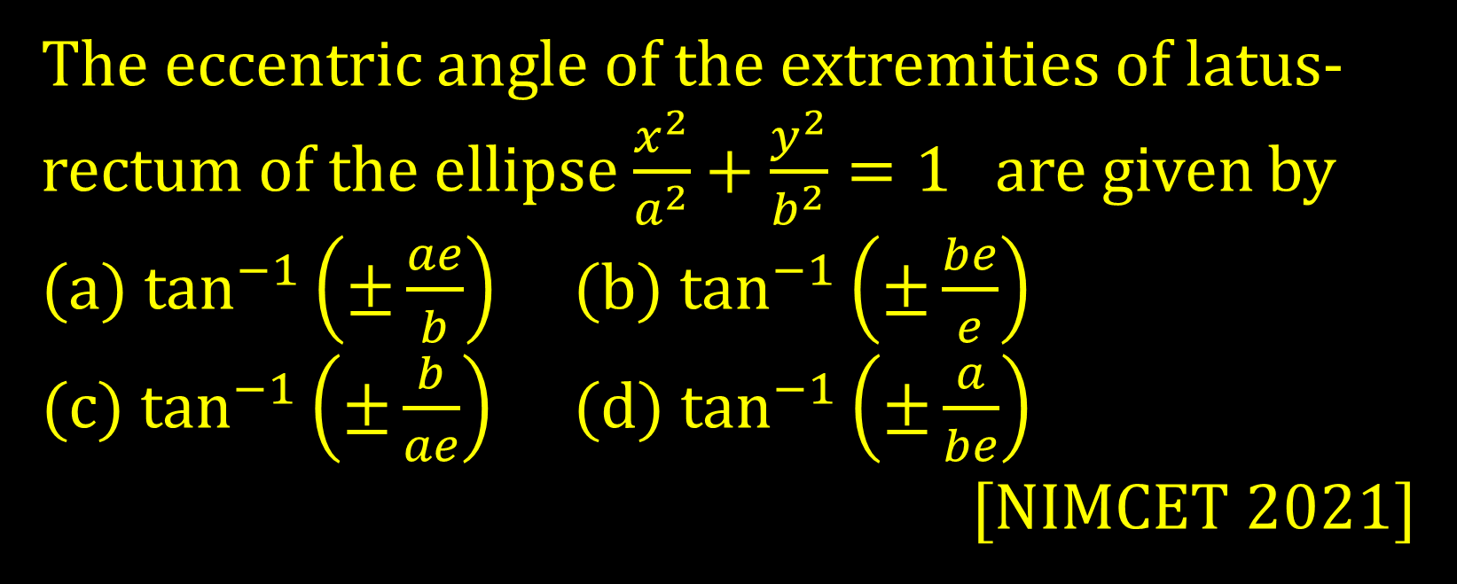
The eccentric angle of the extremities of latus-rectum of the ellipse $\frac{x^{2}}{a^{2}}+\frac{y^{2}}{b^{2}}=1$are given by
(a) $\tan^{−1}\left(±\frac{ae}{b}\right)$ (b) $\tan^{−1}\left(±\frac{be}{e}\right)$
(c) $\tan^{−1}\left(±\frac{b}{ae}\right)$ (d) $\tan^{−1}\left(±\frac{a}{be}\right)$
[NIMCET 2021]

Slide 28
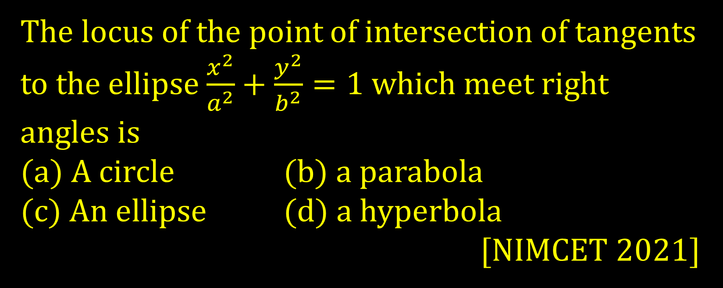
The locus of the point of intersection of tangents to the ellipse $\frac{x^{2}}{a^{2}}+\frac{y^{2}}{b^{2}}=1$ which meet right angles is
(a) A circle (b) a parabola
(c) An ellipse (d) a hyperbola
[NIMCET 2021]

Slide 29
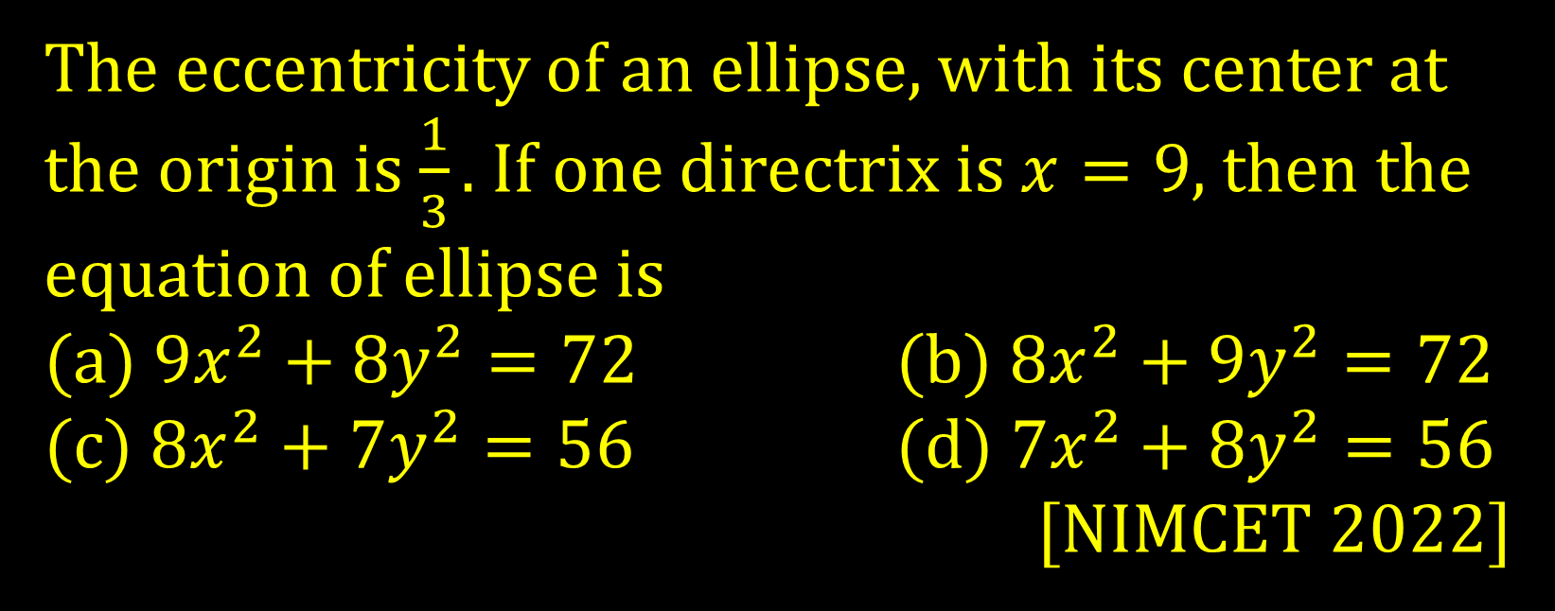
The eccentricity of an ellipse, with its center at the origin is $\frac{1}{3}.$ If one directrix is $x=9$, then the equation of ellipse is
(a) $9x^{2}+8y^{2}=72$ (b) $8x^{2}+9y^{2}=72$
(c) $8x^{2}+7y^{2}=56$ (d) $7x^{2}+8y^{2}=56$
[NIMCET 2022]

